Slide 1
Digital Portfolio
STUDENT NAME: kalaiselvi V
REGISTER NO AND NMID:5F47D855B2AB4A3ADC54E0D0993BE6C4
DEPARTMENT: BSc Computer science
COLLEGE: COLLEGE: Arcot Sri Mahalakshmi woman's college
University: Thiruvalluvar University

Slide 2
PROJECT TITLE DIGITAL PORTFOLIO

Slide 3


AGENDA
Problem Statement
Project Overview
End Users
Tools and Technologies
Portfolio design and Layout
Features and Functionality
Results and Screenshots
Conclusion
Github Link
3/21/2024 Annual Review

Slide 4

PROBLEM STATEMENT
Problem Statement (Inferred from Portfolio Webpage): Create a personal portfolio website for a college student that showcases their passion, education, projects, and contact information. The website should be: Simple and clean in design. Easy to navigate with clear sections such as: About Project Contact Responsive and accessible across different devices. Provide a professional yet personal introduction.. Include links to view the student's work and projects.

Slide 5

PROJECT OVERVIEW
Project Overview: My Portfolio This is a personal portfolio website created by V Kalaiselvi. It includes: A short introduction about who I am Details about my education and interests A section to show my project (this portfolio) A contact section to connect with me The main goal of this project is to share my learning journey, show my skills, and connect with others.

Slide 6

WHO ARE THE END USERS?
The end users of this portfolio website are likely to be: 1. Potential Employers or Recruiters They may visit this site to learn about V Kalaiselvi's background, skills, and projects. They're looking for a quick, clear picture of the candidate’s education, interests, and work samples. 2. Academic Institutions or Professors If applying for internships, research opportunities, or higher studies, professors or admissions officers might review the portfolio.

Slide 7

TOOLS AND TECHNIQUES
Tools and Technology 1. HTML5 – For structuring the web pages. 2. CSS3 – For styling, layout, and design. 3. JavaScript – For interactivity and dynamic elements. 4. VS Code – As the code editor for development. 5. Git & GitHub – For version control and hosting the portfolio. 6. Web Browser – To test and preview the websites

Slide 8
POTFOLIO DESIGN AND LAYOUT
Clear Structure: Sections are well-defined: About, Projects, Contact. Easy to follow and read. Simple Navigation: Top navigation links (About, Projects, Contact) are functional and familiar. Good use of anchor links.
8

Slide 9
FEATURES AND FUNCTIONALITY
Website Title "MyPortfolio": The main title or heading of the webpage, showing it's a personal portfolio. Navigation Menu Links at the top: About Project Contact These help you jump to different sections of the page. Introduction Section Greeting: "Hi, I'm V Kalaiselvi" Tagline: "My passion for learning growth" Call to Action: A clickable link: "View My Work"

Slide 10
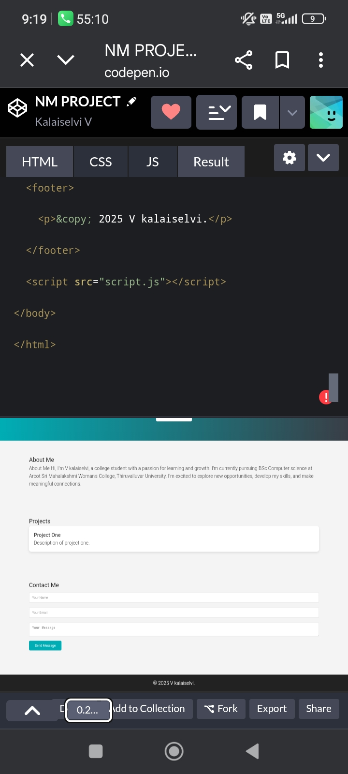
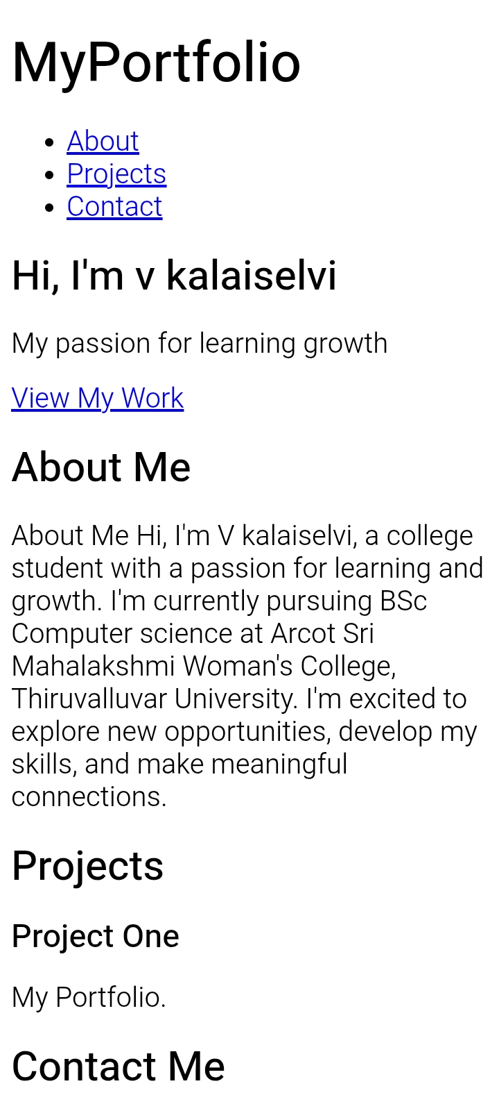
RESULTS AND SCREENSHOTS
3/21/2024 Annual Review
10

Slide 11
CONCLUSION
Conclusion for the Portfolio Website: This is a simple and clear personal portfolio that introduces V Kalaiselvi, a college student pursuing a BSc in Computer Science. The website effectively communicates her: Passion for learning and growth Current education details Motivation to explore, develop skills, and build connections
11

Slide 12
https://github.com/kalaiselvi123142/TNSDC-FWD-DP1.git

